Slide 1
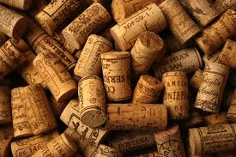
WINE COLLECTOR
Z603: XML Workshop
Kartik Adur, Pallavi Murthy
July 30, 2014

Slide 2
Wine is bottled poetry.
Robert Louis Stevenson
Wine is about…

Slide 3
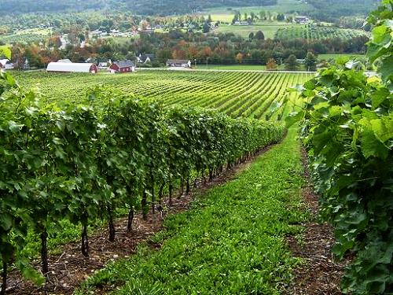
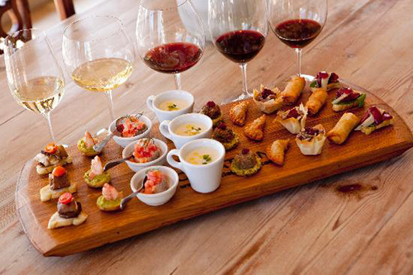
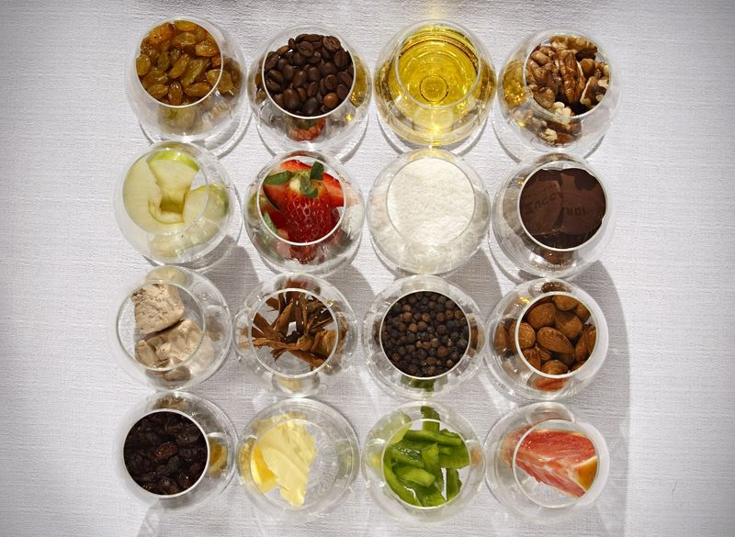
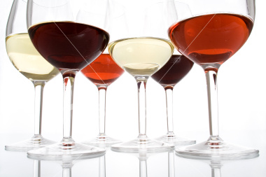
Data
Producer
Region
Aroma
Category
Style
Taste
Color
Vintage
Food Pairings
Temperature

Slide 4
Schema
Wine Collection
Bottle
Producer
vintage
Wine
Serve
Vineyard
Region
Country
Geocode
Latitude
Longitude
Variety
Type
Color
Alcohol By Volume
Descriptors
Acidity
Alcohol
Body
Flower
Fruit
Herb
Inorganic
Oak
Spice
Style
Tannin
Yeast
Best
Good
Temperature

Slide 5
Querying
XPath
XQuery
List all variety of wines with vintage year of 2008
List all wine varieties made in the US
List all wines ordered by the alcohol content by volume
List the descriptions for all Chardonnays
List all wines with a hint of Blueberry

Slide 6
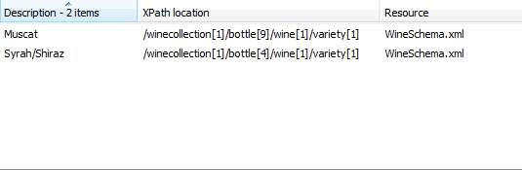
List all variety of wines with vintage year of 2008
//bottle[vintage="2008"]/wine/variety

Slide 7
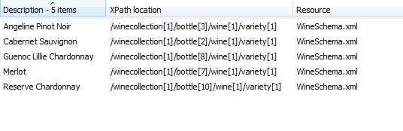
List all wine varieties made in the US
//bottle/producer[country="US"]/ancestor::bottle/wine/variety

Slide 8
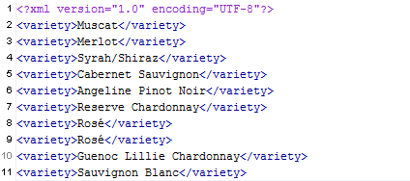
List all wines ordered by the alcohol content by volume
for $x in doc('WineSchema.xml')//bottle where $x/vintage order by $x/wine/alcoholbyvolume descending return $x/wine/variety

Slide 9
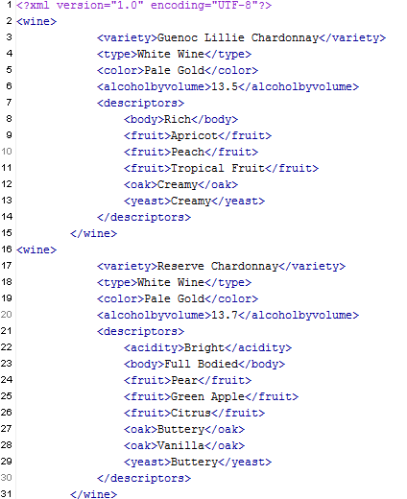
List the descriptions for all Chardonnays
for $x in doc('WineSchema.xml')//bottle where $x/wine[contains(variety,'Chardonnay')] return $x/wine

Slide 10
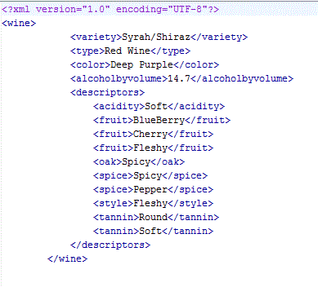
List all wines with a hint of Blueberry
for $x in doc('WineSchema.xml')//bottle where $x/wine/descriptors/fruit/text() = 'Blueberry' return $x/wine

Slide 11
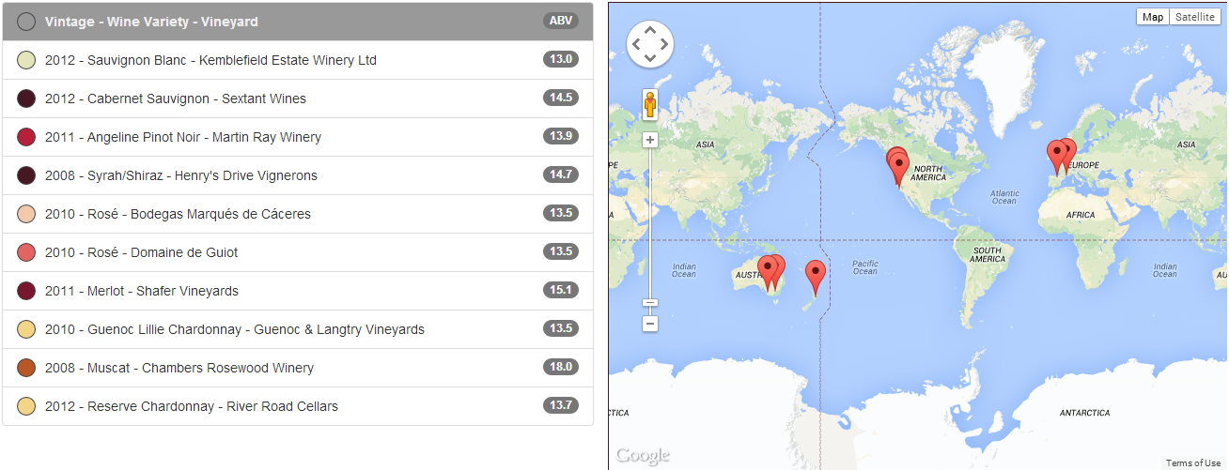
Data Presentation in XSLT
<xsl:template match="/"> <xsl:for-each select="//bottle"> <li class="list-group-item bottle clearfix" data-lon="{producer/geocode/longitude}" data-lat="{producer/geocode/latitude}"> <span class="color {translate(translate(wine/color, $uppercase, $lowercase), $space, $dash)}" ><blank/></span> <xsl:value-of select="vintage"/> &#45; <xsl:value-of select="wine/variety"/> &#45; <xsl:value-of select="producer/vineyard"/> <span class="badge" style="float:right;"><xsl:value-of select="wine/alcoholbyvolume" /></span> </li> </xsl:for-each> </xsl:template>

Slide 12



